Slide 1


Hybrid Cloud Data Movement

Slide 2
TABLE OF CONTENTS
Project Statement
Project Overview
Project Requirements
Architecture Diagram
Technologies / Tools Used
Methodology & Approach
Execution Overview
Implementation – Tasks Performed
Practical Implementation on Azure Portal
Successful Output Generated
Conclusion

Slide 3
PROJECT STATMENT
Implement a solution that involves moving data between on-premises data sources and Azure cloud using Azure Data Factory, and perform data processing tasks in Azure Databricks.

Slide 4
PROJECT OVERVIEW
Demonstrates secure, automated migration of data from on-premises SQL Server to Azure using Data Factory and scalable processing in Databricks. Highlights hybrid pipeline bridging enterprise and cloud analytics.

Slide 5
Project Requirements
On-prem SQL Server
Windows host for Self-hosted Integration Runtime
Azure subscription
Data extraction permissions
Familiarity with Azure Portal, Data Factory, and Databricks

Slide 6
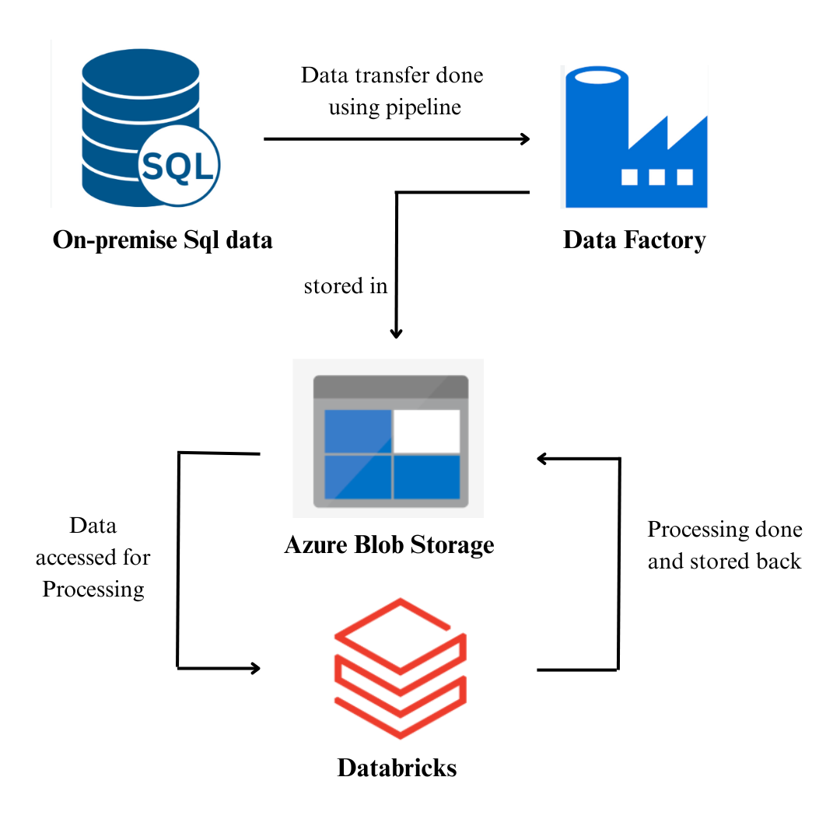

ARCHITECTURE DIAGRAM
This architecture shows how the Self-hosted Integration Runtime enables a secure connection between Azure Data Factory and the on-premises SQL Server, with transferred data landing in Azure Blob Storage and being subsequently processed in Azure Databricks notebooks.

Slide 7
Technologies / Tools Used
SQL Server (on-premises)
Azure Data Factory
Self-hosted Integration Runtime
Azure Blob Storage
Azure Databricks (Spark, Python, SQL)
Windows Server/PC

Slide 8
Methodology & Approach
Structure DB in SQL Server
Install Self-hosted IR
Configure Data Factory linked services
ADF pipeline moves data to Blob Storage
Databricks processes/cleans/transforms in notebooks
Results saved in cloud storage

Slide 9
Execution Overview
ADF pipeline extracts/stages data from SQL Server
Databricks cluster processes data from Blob Storage
Data cleaned, analyzed, transformed, saved
Resources terminated upon completion

Slide 10
Implementation – Tasks Performed
Prepared SQL Server tables
Installed/registered IR
Configured Data Factory linked services
Built/published Copy Data pipeline
Validated Blob file arrival
Set up Databricks workspace/cluster
Processed data and saved results

Slide 11
Practical Implementation on Azure Portal
1. Initial Setup
Log in to Azure Account
Create Azure Data Factory instance
Set up Azure Storage account
Create Blob Storage container

Slide 12
Practical Implementation on Azure Portal
2. On-premises Setup
Install SQL Server Management Studio (Express Edition)
Create database and tables in SSMS
Create SQL Server Authentication login

Slide 13
Practical Implementation on Azure Portal
3. Azure Data Factory Pipeline Setup
Author new pipeline in Data Factory
Add Copy Data activity with SQL Server source
Configure linked service for SQL Server
Set up self-hosted Integration Runtime (IR)
Install and register IR using Azure portal key

Slide 14
Practical Implementation on Azure Portal
4. Data Transfer Configuration
Provide SQL Server credentials in IR linked service
Select source table and preview data
Configure sink dataset as Azure Blob Storage
Choose delimited text file format
Set up Blob Storage linked service and container
Publish pipeline and add trigger

Slide 15
Practical Implementation on Azure Portal
5. Post Transfer Processing
Verify data file appears in Blob Storage
Set up Azure Databricks workspace and cluster
Create notebook for data cleaning, filtering, renaming, transforming
Save processed output to Blob Storage

Slide 16
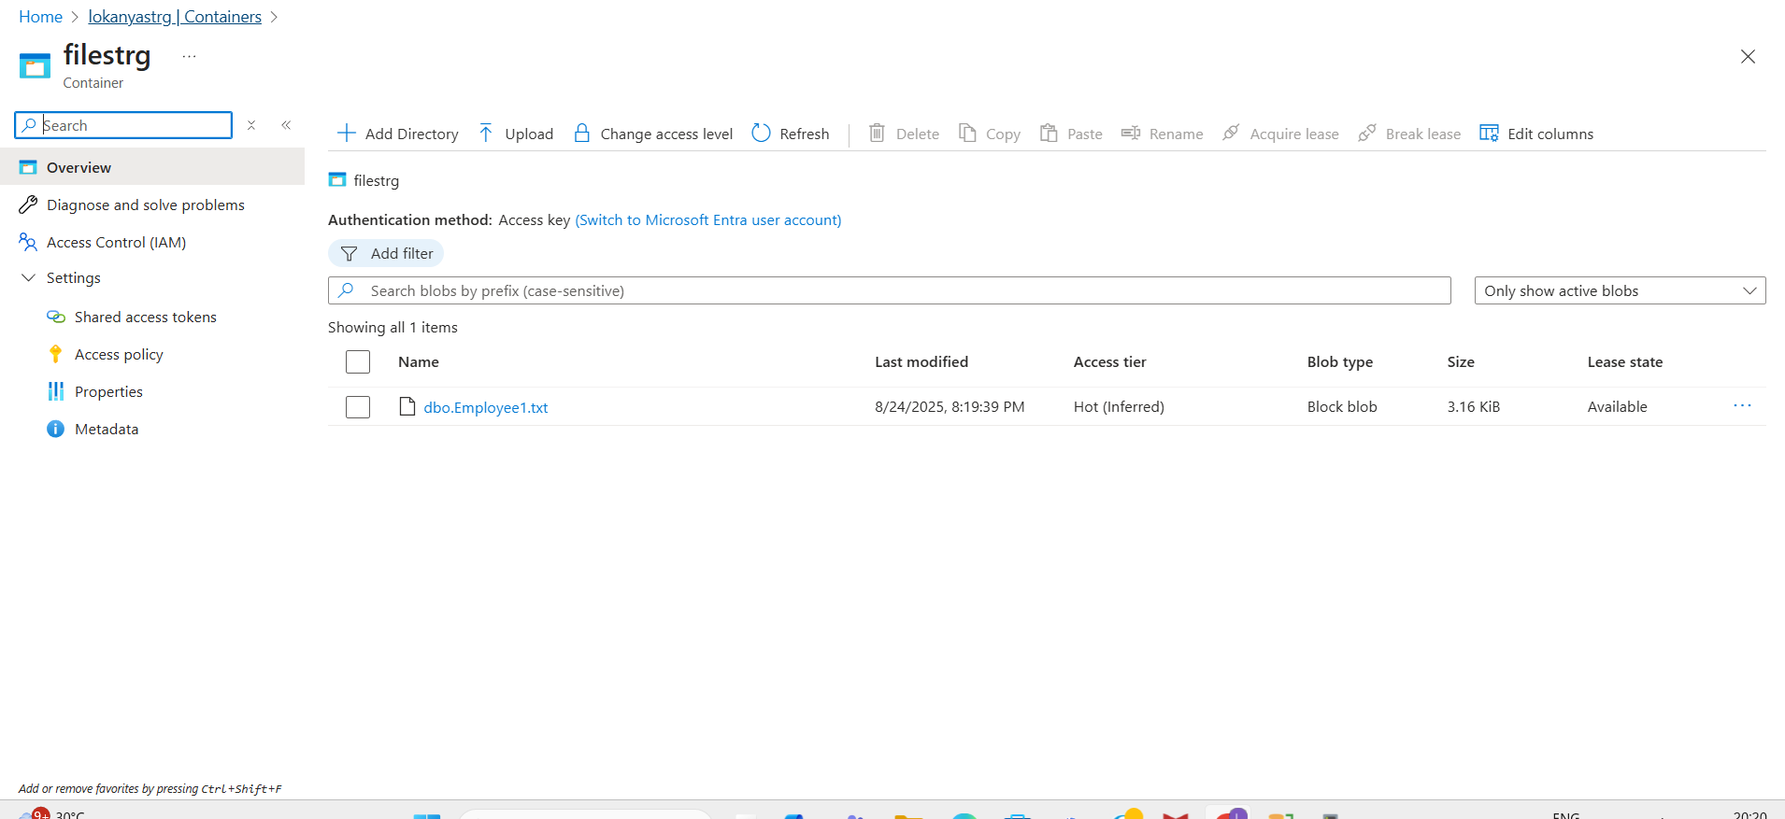
SUCCESSFUL OUTPUT GENERATED

Slide 17
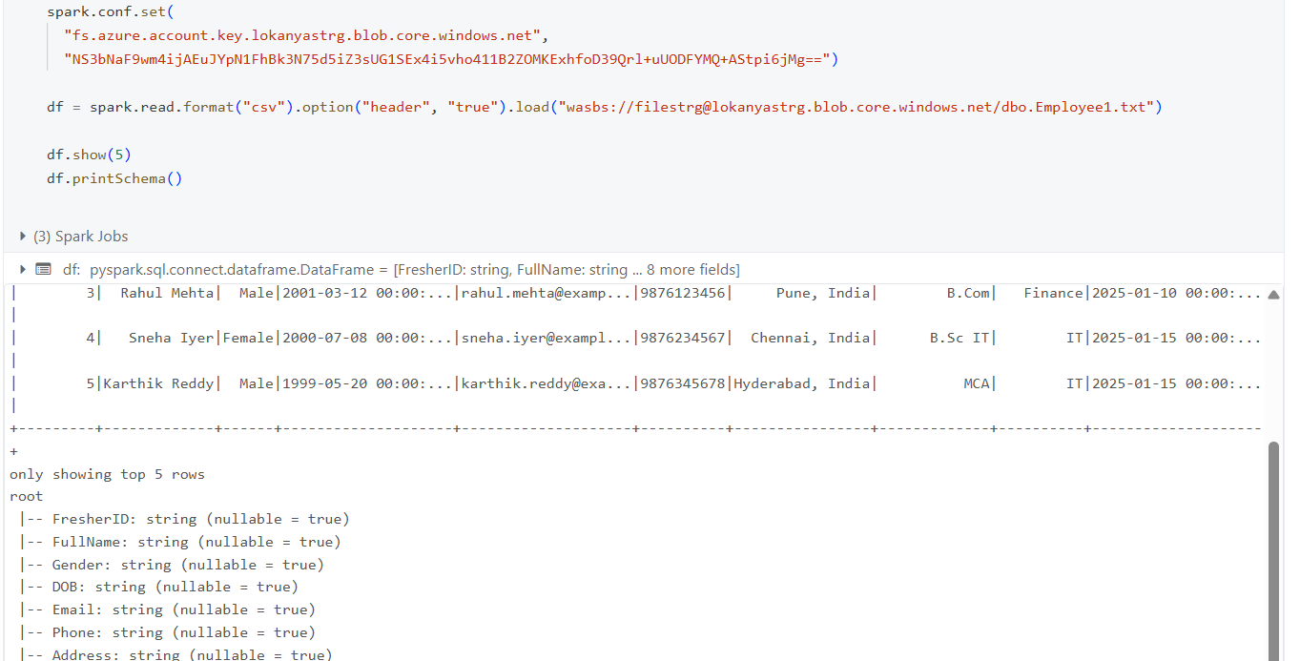
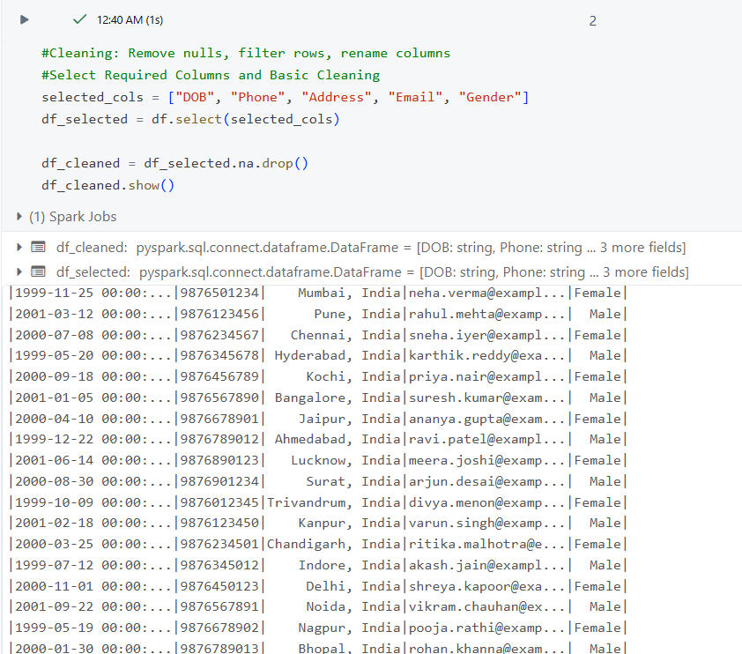
SUCCESSFUL OUTPUT GENERATED
Loading Data
Cleaning Data

Slide 18
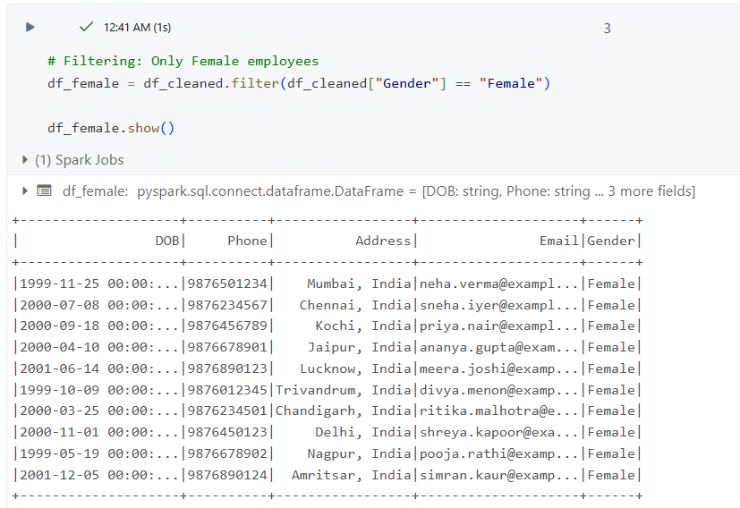
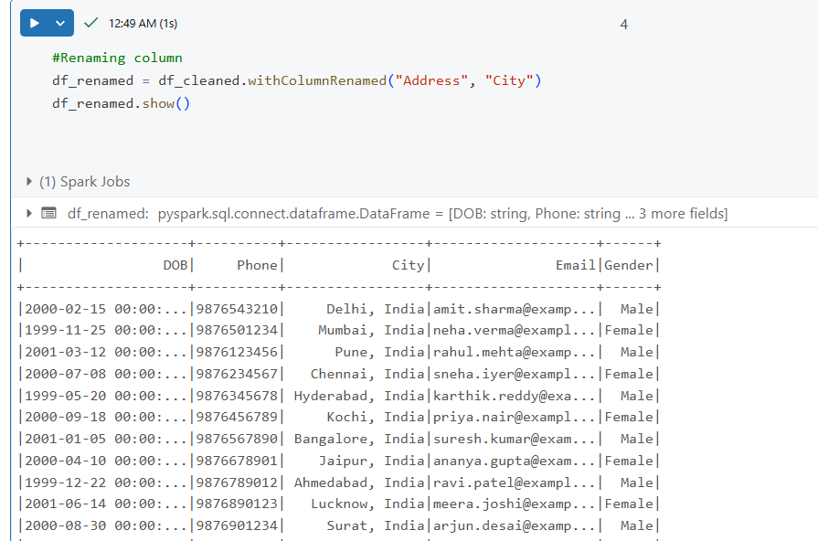
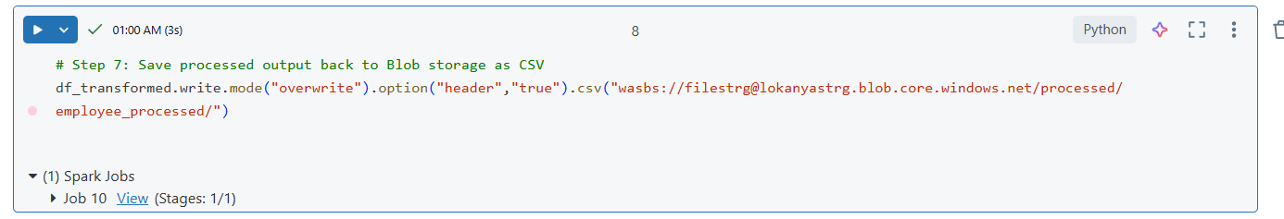
SUCCESSFUL OUTPUT GENERATED
Filtering Data
Renaming Data
Saving Data

Slide 19
CONCLUSION
This project demonstrates a secure, scalable hybrid cloud data solution, streamlining migration, processing, and providing a reusable enterprise architecture for future analytics and BI initiatives.

Slide 20
THANK YOU !

